Slide 1
Title IX Team Meeting
6.2.2022

Slide 2



Review of 2020 regulations
Do you remember 2020?
Yeah---me neither..

Slide 3
Review of 2020 regulations
On May 6, 2020 – The Department of Education published new Title IX regulations which contained major changes to the scope and application of Title IX matters. The new regulations were effective August 14, 2020.
The regulations prohibited a narrow range of behaviors the OCR called “sexual harassment,” a confusingly broad term that includes not just quid pro quo and hostile environment sexual harassment, but also the crimes addressed by VAWA: sexual assault, domestic violence, dating violence, and stalking.

Slide 4
Review of 2020 regulations
The regs narrowed the response required by institutions:
Institutions must respond when the reported sexual harassment occurs in educational programs or activities within the US (Title IX Complaints). Institutions may address sexual harassment affecting its students or employees that falls outside Title IX’s jurisdiction in any manner the school chooses.
This change resulted in most institutions adopting a 2-prong framework for addressing sex discrimination:
  NDSCS created a separate Sexual Misconduct policy to address reports of sexual misconduct that do not meet the strict definitions under Title IX.

Slide 5
NDSCS Title IX Compliance v.
Sexual Misconduct policy
So.. What’s the difference?
The NDSCS Title IX Compliance Policy applies to formal complaints of sexual harassment occurring in NDSCS Educational Programs or Activities within the United States.
  Educational program or activity includes: locations, events, or circumstances over which NDSCS exercises substantial control over both the Respondent and the context in which the sexual harassment occurs, as well as in any building owned or controlled by a student organization that is officially recognized by NDSCS. This includes:
    Reported sexual harassment that occurs in any building or property owned by NDSCS (residential buildings, academic buildings, the BAC)
    Reported sexual harassment that happens through a remote learning platform, during a class fieldtrip, at an athletic or arts event
      within the United States

Slide 6
NDSCS Title IX Compliance v.
Sexual Misconduct policy
The NDSCS Sexual Misconduct policy applies to formal complaints of sexual misconduct involving an NDSCS student or employee, regardless of the location or context in which it occurred, that are NOT under the jurisdiction of Title IX, such as:
  Reported sexual misconduct involving an NDSCS student or employee, that occurred off campus, within study abroad program, or at any location, event or circumstances that NDSCS does not have any affiliation with.

Slide 7
Review of 2020 regulations
Revisions to Definitions:
  Requires definitions of sexual assault, dating violence, domestic violence and stalking that are found in the VAWA amendments to the Clery Act. These definitions include legal terms that are grounded in criminal law (i.e., rape, fondling).
  Prior to 2020 regulations, sexual harassment had a broader definition which included ‘unwelcome conduct determined by a reasonable person to be so severe, pervasive or objectively offensive.’ 2020 regs revised to conduct ‘so severe, pervasive and objectively offensive.’

Slide 8
Review of 2020 regulations
Revisions to Process:
  If the complainant requests to move forward with a formal complaint, a Notice of Allegations document must be provided to the respondent (and complainant) prior to interviewing the respondent or any other parties and contain specific language.
  At least 10 calendar days prior to the preparation of the Preliminary Investigative Report, Investigators must provide each party and their advisor, the evidence obtained in the investigation in an electronic format or hard copy.
  The Investigator creates the Preliminary Investigative Report that summarizes the relevant evidence and any comments/information provided by the parties in the 10-day review period.
  At least 10 calendar days prior to the hearing, the Investigator must send a copy of the Preliminary Investigative Report to each party and their advisor, if any, for review and written response.

Slide 9
Review of 2020 regulations
Revisions to Process continued..
In Title IX complaints, NDSCS is required to hold a live hearing that is presided by an independent Hearing Officer.
Hearing requirements:
    The parties must be able to see and hear each other, but they can be in separate rooms and the hearing can be performed virtually.
    The complainant and respondent MUST each have an Advisor present, without exception. The Advisors ask questions of the other party; the parties may not question one another directly.
    Students may use their own Advisors, but if they do not have one or request one, NDSCS must provide an Advisor who is trained in the grievance process.
    NDSCS must create an audio or audiovisual recording, or transcript, of any live hearing and make it available to the parties for inspection and review.

Slide 10
Review of 2020 regulations
Revisions to Process continued..
  The suppression provision – “If a party or witness does not submit to cross-examination at the live hearing, the decision-maker must not rely on any statement of that Party or witness in reaching a determination regarding responsibility.”
  If a party participated in the entire investigation, answered 50 questions during an investigation and answered 5 of 6 questions during the live hearing - because they didn’t answer the 1 question, the decision-maker was not allowed to rely on any other statements that party made throughout the hearing or the investigation.
In July 2021, a federal judge in Massachusetts vacated that part of the regulations as the court found it to be manifestly unfair.
NDSCS will be removing this paragraph from the Title IX Compliance Policy in the next update.

Slide 11
Review of 2020 regulations
Back to the revision to the definition of Sexual Harassment..
Institutions are required to train Title IX teams on the definition of Title IX Sexual Harassment, which is outlined in the NDSCS Title IX Compliancy Policy as:
  Conduct, on the basis of sex, constituting one (or more) of the following:
      An employee of NDSCS conditioning the provision of an aid, benefit, or service of NDSCS on an individual’s participation in unwelcome sexual conduct (Quid Pro Quo);
      Unwelcome conduct determined by a reasonable person to be so severe, pervasive, and objectively offensive that it effectively denies a person equal access to NDSCS’s educational program or activity; or
      Sexual assault, dating violence, domestic violence, or stalking, as defined in this section.

Slide 12
More changes coming?
The Department of Education was expected to issue a Title IX proposal in April 2022 – this did not happen. The next timeline to release the draft proposal was May 2022.
What could change?
  The judiciary-like requirements of the required live hearing and cross-examination through an advisor
  The narrow definition of Title IX sexual harassment complaints
  Additional protections for gay and transgender students from sex-based discrimination

Slide 13
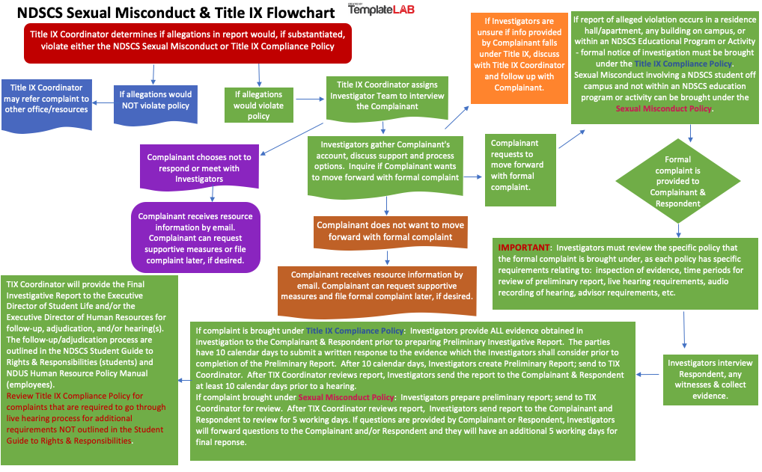

Slide 14
March 2022 VAWA Reauthorization
The Clery Act mandates procedures for sexual violence response by institutions of higher education, separate and in addition to Title IX regulations.
During the Trump administration – aid and programs for protections and assistance for survivors of domestic violence and sexual assault were cut significantly.
In March 2022, President Biden signed into law the VAWA (Violence Against Women Act) Reauthorization Act of 2022 - effective October 1, 2022. The reauthorization will:
  Renew all current VAWA grant programs until 2027
  Increase services and support for survivors from underserved and marginalized communities, including LGBTQIA+ survivors
  Support State, Tribal and local government efforts to prevent and prosecute cybercrimes, including cyberstalking and the nonconsensual distribution of intimate images.
  Expand prevention education for higher education students

Slide 15
VAWA Reauthorization implications for the title ix field
Definitions within VAWA were modified and will be effective October 1, 2022.
  Revision to the domestic violence definition to include economic abuse and technological abuse
The Secretary of Education is required to develop an online survey that each higher education institution that receives federal assistance must administer to their students.
  gather information on postsecondary student experiences with domestic violence, dating violence, sexual assault, sexual harassment and stalking.
  Survey will need to be disseminated to students not later than 1 year after the survey tool is available and every two years thereafter.

Slide 16
VAWA Reauthorization implications for the title ix field
Not later than September 1, 2022, the Secretary of Education and other governmental groups must establish a task force on sexual violence in education. This task force will provide an array of information to campuses such as:
  Sexual violence prevention, best practices for investigations, survivor resources, recommendations on culturally responsive and inclusive approaches to supporting survivors
Many grant opportunities, including grants for Title IX investigator training, prevention and education programming
October 1st has been designated as “Choose Respect Day.” All are encouraged to recognize this day through proclamations, activities and educational efforts to further changing the culture around the tolerance of violence against women.

Slide 17
?review of changes to policies?

Slide 18
reminder
Title IX Training with Grand River Solutions in Old Main 130E:
  Wednesday, July 13th from 12:30 – 4:30 pm; and
  Thursday, August 4th from 12:30 – 4:30 pm

Slide 19

Questions?

